Slide 1
A Discussion of Secrets
Robert Stewart

Slide 2
Agenda
Intro
Talk about Social Engineering
Talk about Social Engineering some more
Still talking about Social Engineering
Roll Credits

Slide 3
Hi :)
What I do:
network
web application
mobile
electronic social engineering
physical social engineering
I break into things for a living, let's talk about it.
Robert Stewart
Security Consultant

Slide 4
New Presentation, Who dis?
Tell me about yourself
⃞ C Level
⃞ Admins
⃞ Practitioners

Slide 5
Check One
Have you ever heard about Social Engineering?
⃞ Yes ⃞ No

Slide 6

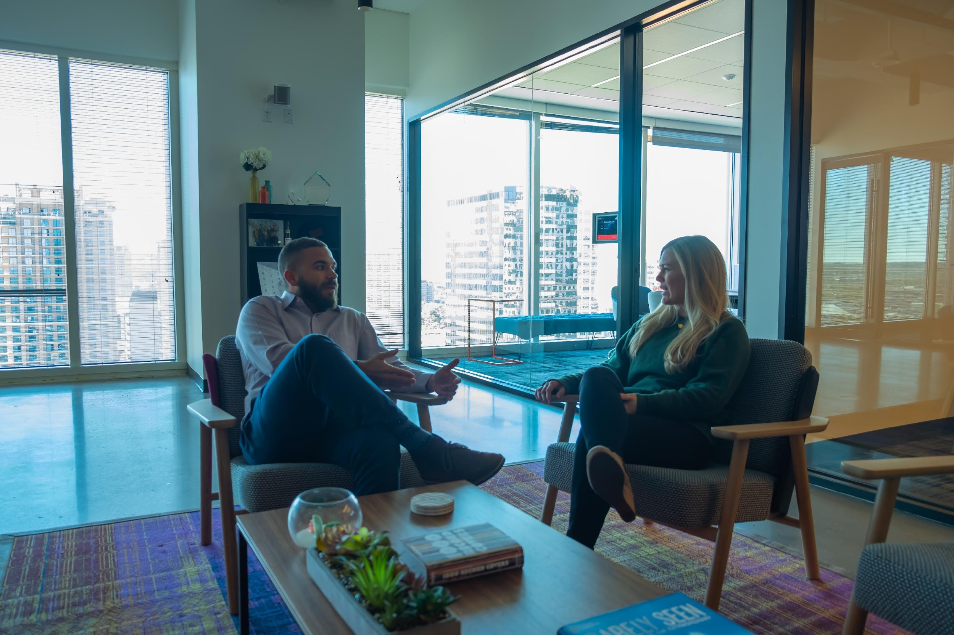

Notes:
Story #1:
NY Bank, Manhattan and impossible building to get in
Why was I successful?
Security didn't stop me. #WTF
Security didn't stop me the second time!!! #OMG
Employees didn't engage me because I was dressed in a suit.
What should have happened?
Security should have been more vigilant and asked me to leave when I didn't badge in.
Employees should have been more proactive on kicking me out.
I should have been asked to leave!

Slide 7
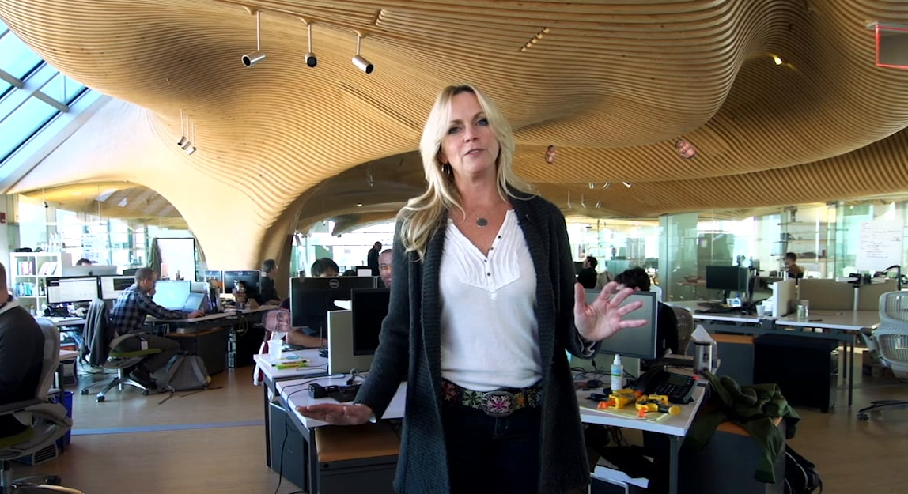
‹#›
Notes:
Story #2:
Office - Active Shooter training
Why wasn't I successful?
Employee’s were on their game from the get go!
Only public space was a very tiny waiting room / hallway.

Slide 8
Notes:
Story #3:
Office - Leon, Shane #MadProps!!!
Why were we successful?
Poor data management.
Culture allowed for tailgating.
No one questioned us.
The gap between doors and door jams allowed for us to bypass locks.
What should have happened?
I should have been questioned more.
I should have been asked to leave!
Part 2:
Shirts got us into a branch office, onto the network, and we stole a box full of documents.

Slide 9
IT’s Been a Pleasure
Thank You For Your Time

